Slide 1

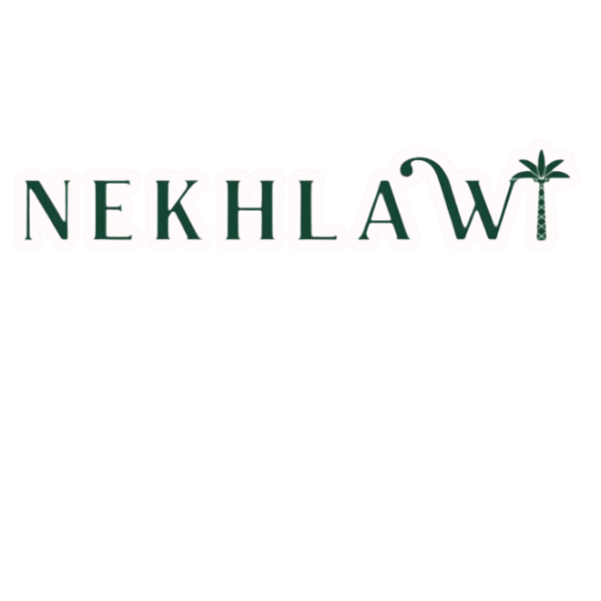
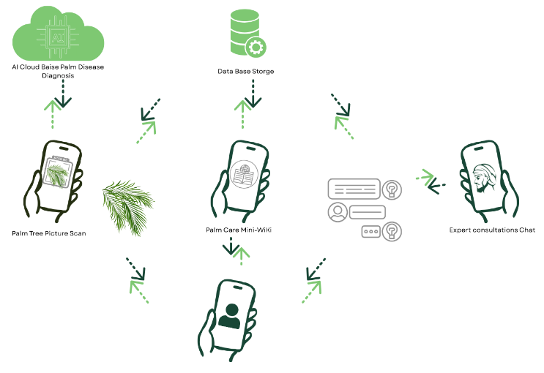
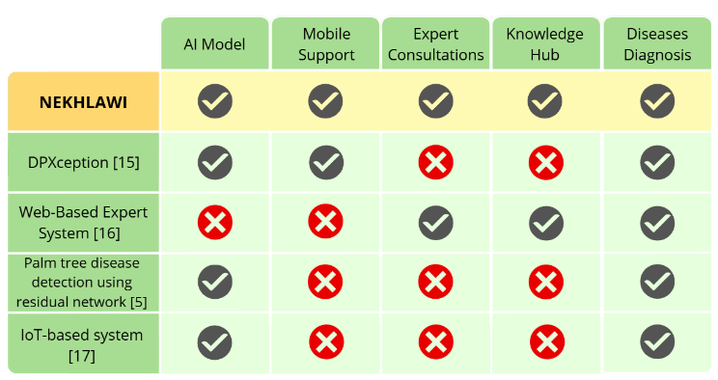
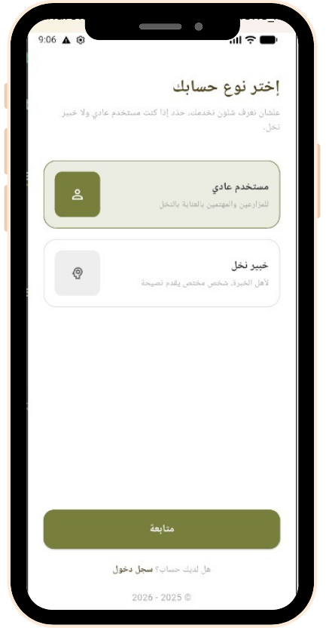
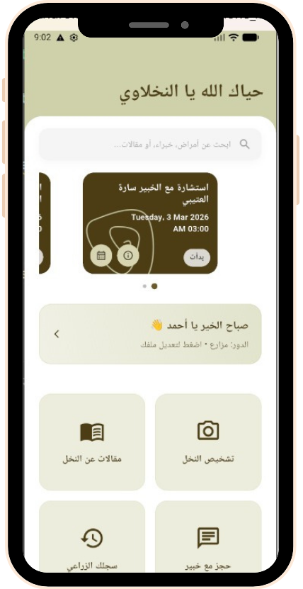
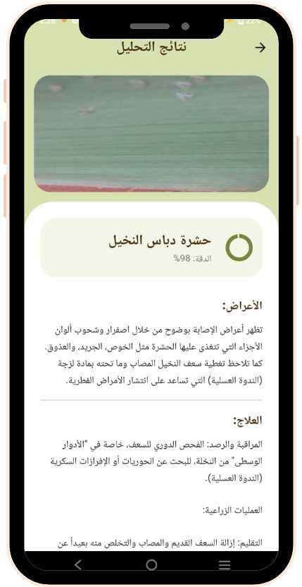
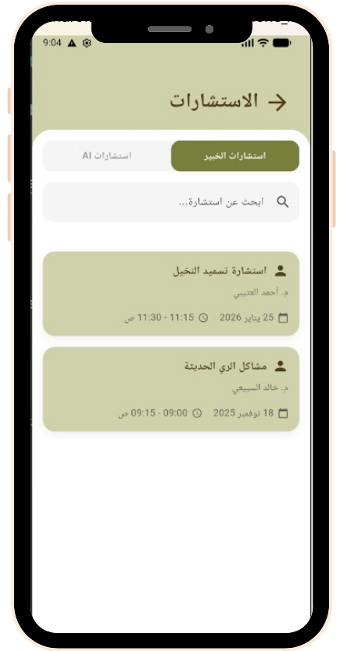
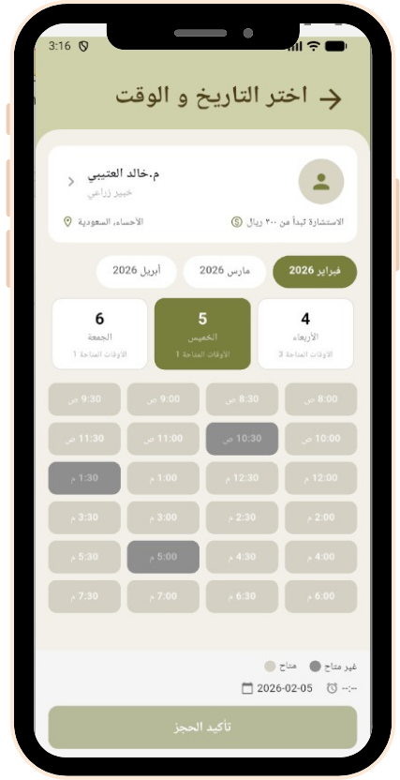
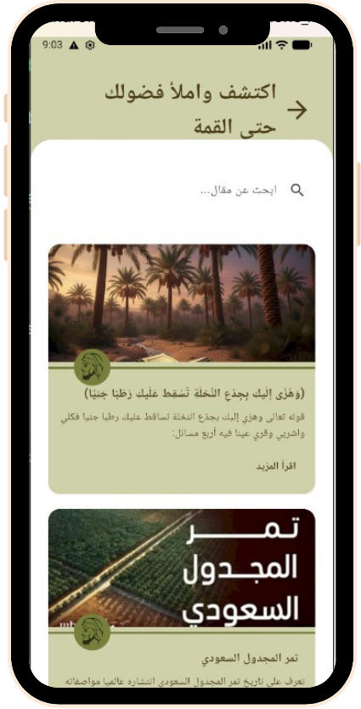
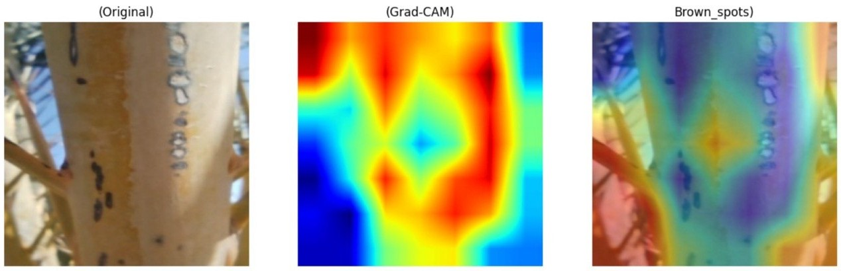
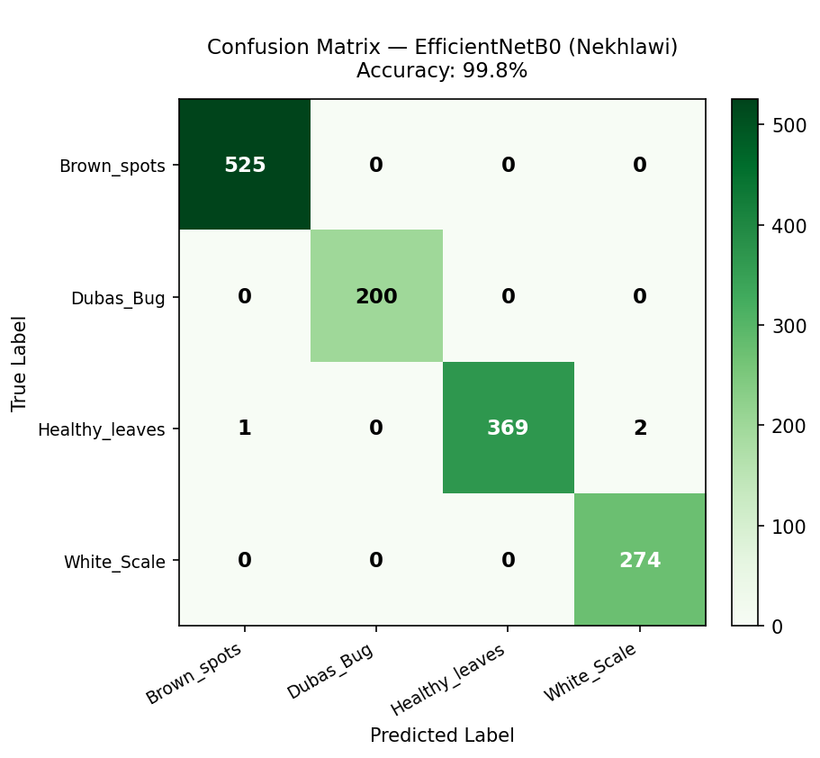
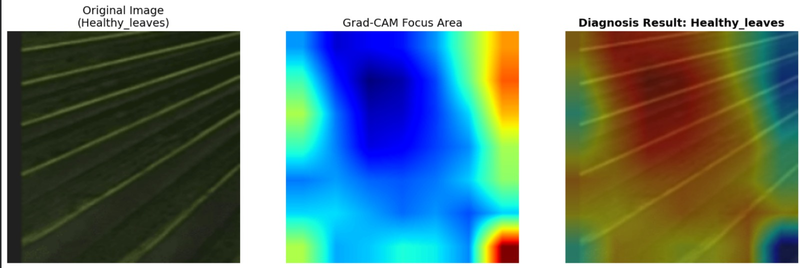
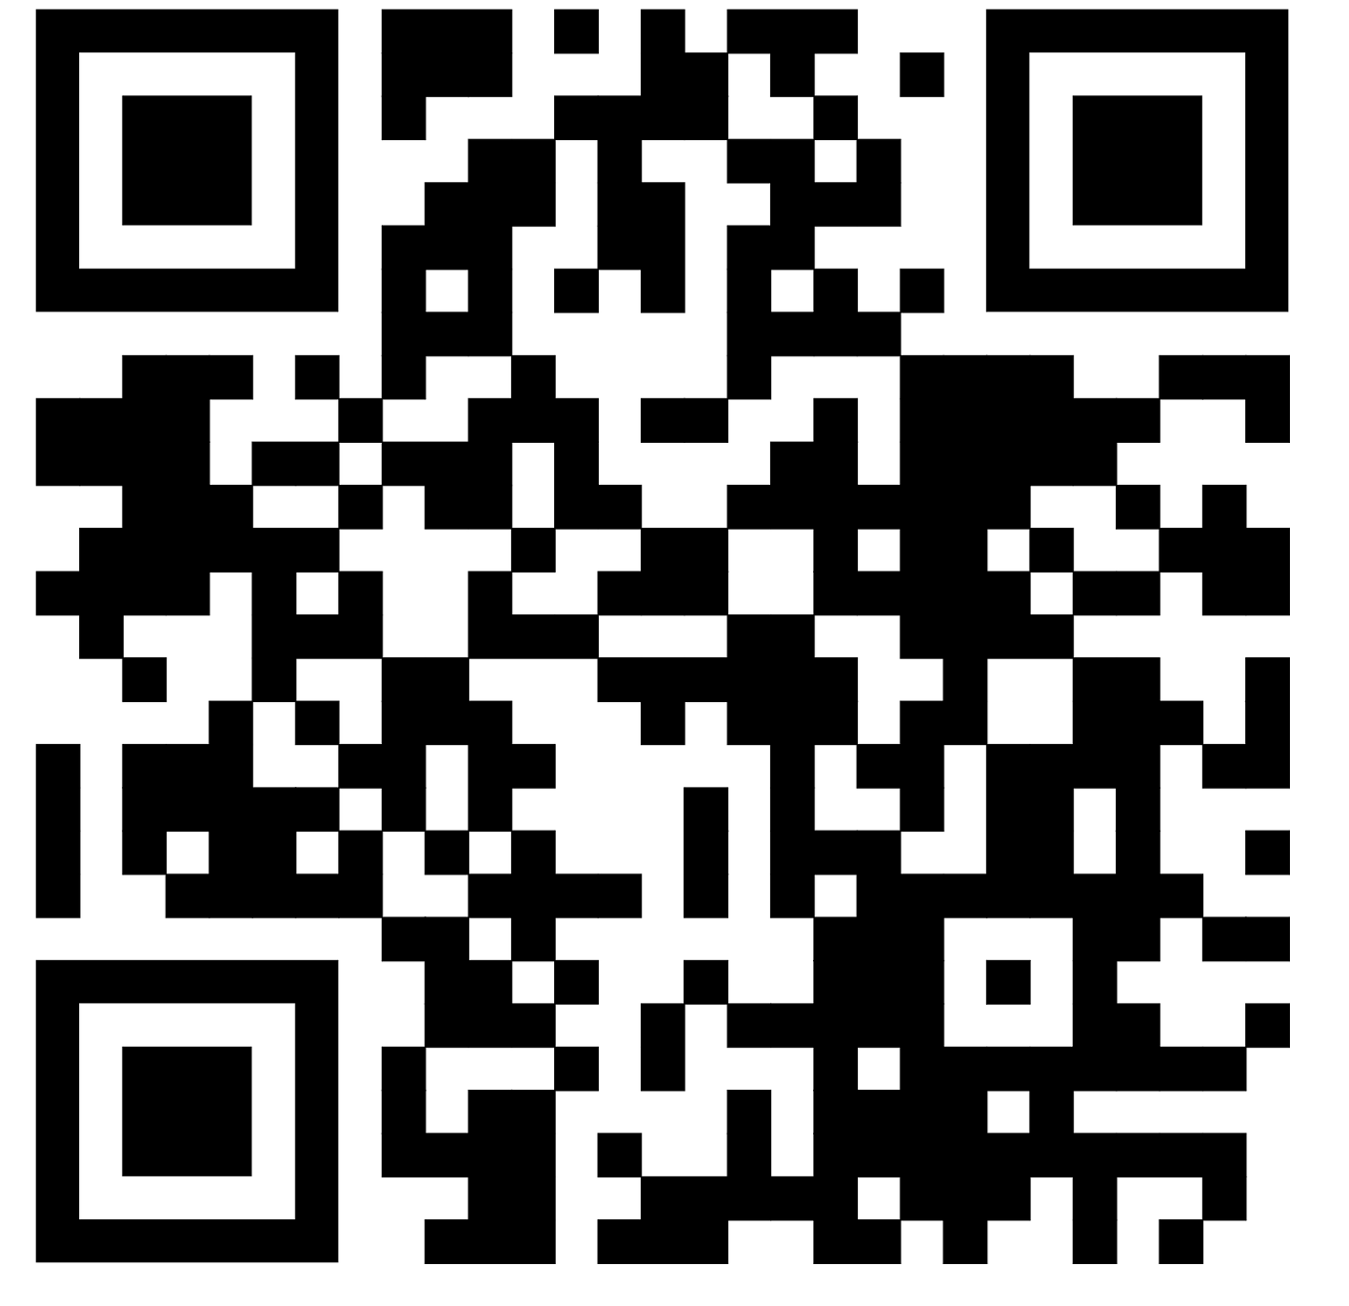








NAKLAWI: An Inteligent Diagnosing and Knowlede Mobile Platform for Palm Care
Prepered By: Zainab Albadi, Hebah Altheyab, Zinab Alrashed, Doja Alnemer, Donia Alfarhan.
Supervised By: Mrs. Albandary Alamer
System Overview
1
5
Introduction
The agriculture and heritage of Saudi Arabia are largely dependent on date palm farming. which, has not been as lucrative lately because of the inability of majority of small-scale palm owners to take proper care of the trees. In order to solve this, we have come with Nekhlawi app that serves to diagnose diseases, prescribe treatment, and connect with specialists with the help of the AI. A survey was done to palm owners as well as agricultural experts to ascertain that the app has been designed to meet the needs of the user.
Problem Statement
2
The owners of date palms are experiencing enormous challenges that put their farming sustainability under serious threat mainly because of several diseases that affect the production and the survival of palms resulting in an economic loss estimated to be 28 percent of the entire production. Moreover, the knowledge that is possessed by highly qualified farmers can easily be lost since there is no effective documentation. These unresolved problems show that there is an urgent demand to find innovative solutions to overcome the gap between the accessibility of technologies and the preservation of agriculture.
Proposed Solution
6
Nekhlawi is a one-stop AI-based mobile platform that fills the gap between the traditional farming and modern technology by: using AI-Driven Diagnosis, Expert Connectivity.
Results
7
Gap Analysis
3
Developed Nekhlawi, an AI-based application that detects palm diseases through image analysis and deep learning
Creating a hub for accessing knowledge and having a connection with experts
Provide a solution that supports digital transformation in agriculture and enhances sustainability
Survey Results
4
Trained the EfficientNetB0 AI model on computer vision and classification to diagnose date palm tree diseases which reached the optimal accuracy of 99.8%
To ensure the Nekhlawi App effectively addresses user needs, a comprehensive survey was conducted. The survey primarily focused on the following key questions:
Implemented GRAD CAM to provide the end-user model transparency and explainable AI
Users face challenges in palm tree disease diagnosis
High interest in using a palm tree care mobile application
Tools
Conclusion
9
8
Nekhlawi proposes a solution to reduce the time for detecting palm diseases, improving the future of agricultural technology and minimizing losses of efforts and money through image processing. With the integration of the knowledge hub and experts’ connection, empowering users' decision-making.

